Slide 1

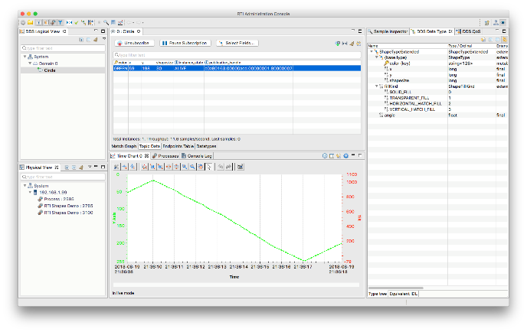
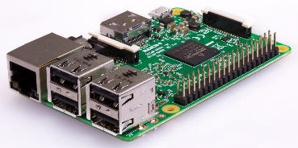
INTERWEB
Amazon Web Services
AWS_IP: 50.18.214.8
DDS DataBus
<<Domain 20>>
Routing Service
Web Integration Service
RESTful
Info
https://<AWS_IP>:8090
https://<AWS_IP>:9900
DDS DataBus
(TCP to AWS)
Pulse
<<Domain 10>>
Web page
bootstrap, chart.js
Config
Routing Service
DDS DataBus <<Domain 0>>
C++
Arduino
Info
Pulse
Config
Smoothing
Patient Correlation
*(Beat detection done on Arduino)
Pulse sensor
Pulse
Analog
USB
Servo simulates infusion pump
Raspberry Pi
Version 0.94

Slide 2
Notes
Pi/sensor setup
May need Arduino between Pi & Sensor to reduce jitter
Target sample rate of 150 Hz for pulse sensor
Optional: Use a simple servo to simulate infusion pump operation
Use batching for data transmission
Web interface
WIS web page leverages chart.js for real-time pulse graph
Need to figure out how many updates/sec chart.js can handle
Need another Javascript lib (bootstrap) to add button for infusion pump

